Slide 1

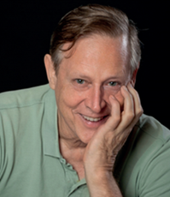
Update
October 13
To Earn Money Effortlessly

Slide 2
My 5 pillar philosophy
Pillar 1: Investing in gold/silver and uranium/copper (15%)
Pillar 2: Real estate investments such as E-Estate on hold and home equity (20%)
Pillar 3: Cryptocurrencies or crypto companies such as, XRPaibot (XABclub), VortexCapital, OrbitOne (formerly Aurum on hold), BTC, XLM and XRP (25%), also crypto wallets
Pillar 4: Loans such as NeoFinance and FinoMark (15%)
Pillar 5: Special projects such as QFS projects, New York project, Chronimy, Sruth crypto trading, Skyway (SWC → Micron Global), Bytnex (15%)
Cash: 10% in gold
Remarks: Only use your spare money

Slide 3
General information
To Earn Money Effortlessly

Slide 4

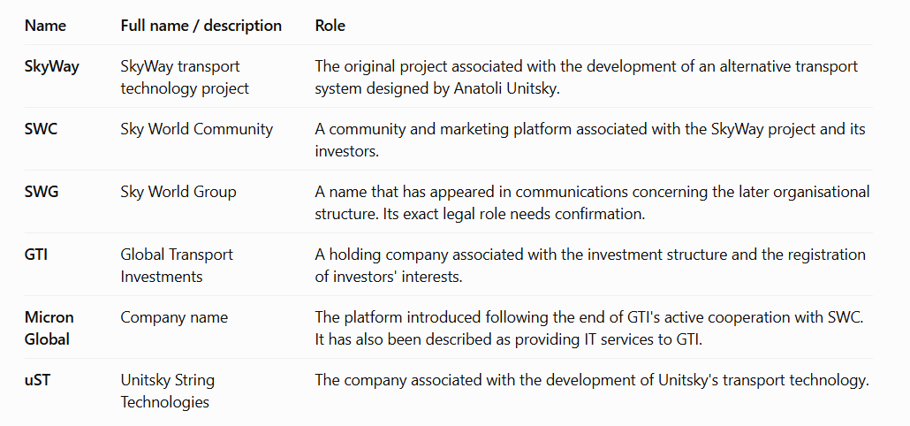

Slide 5
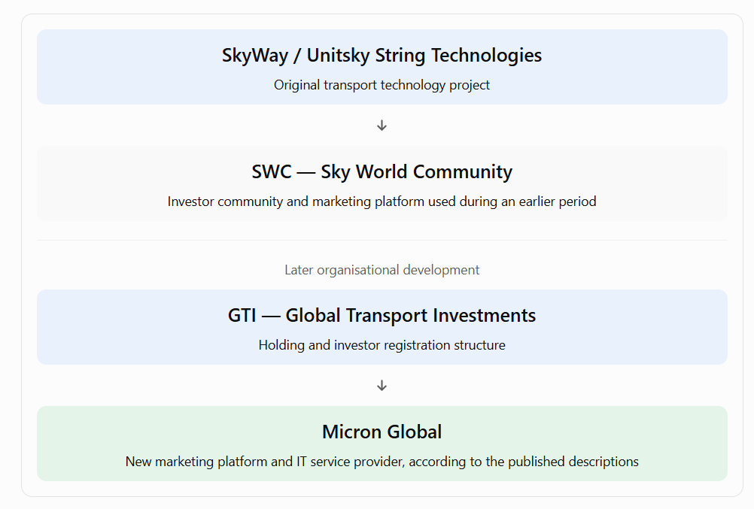

Slide 6
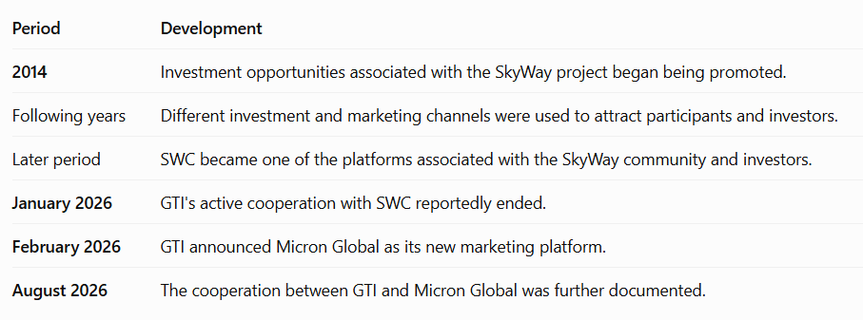

Slide 7
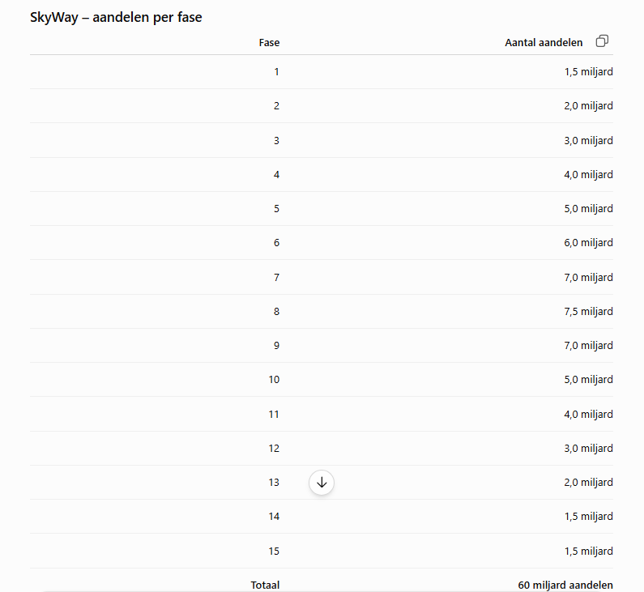
There is a total of 400 billion shares, of which 60 billion are held by private investors and carry a dividend entitlement. In total, 280 billion shares are entitled to dividends.

Slide 8
Letters from Micron Global
To Earn Money Effortlessly

Slide 9
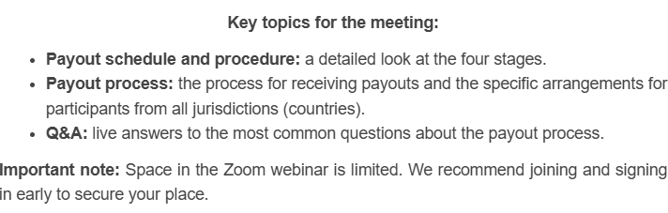
The information from October 5, 2026 (1/1)
https://s9363070.sendpul.se/sl/MjQwNDc4Mjo5MzYzMDcw/f3764ea4a8d1ce6242387a36d7ca45fccd27fs10
The Zoom meeting will take place on October 8, 2026, at 13:00 UTC
(15:00 Dutch time)

Slide 10
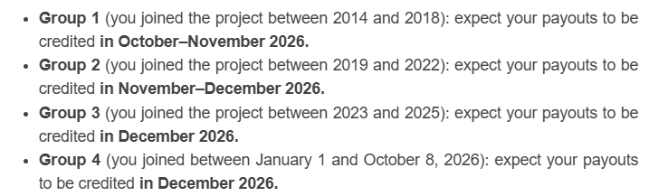
The information from October 6, 2026 (1/3)

Slide 11
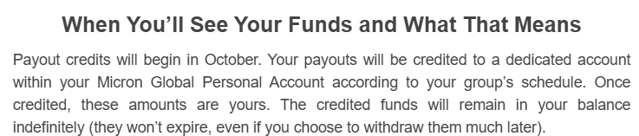
The information from October 6, 2026 (2/3)

Slide 12
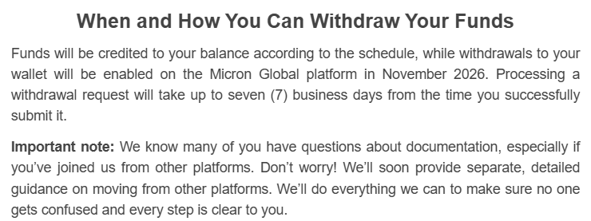
The information from October 6, 2026 (3/3)

Slide 13
The information from October 8, 2026 (1/2)
There was a Zoom meeting today with Maksym Isyp (CEO of MicronGlobal).
A lot was discussed, but I only noted down the key points: 1) There is a list of excluded countries, such as the USA, Iran, etc. If you live in such a country, you will receive special instructions.
2) The cut-off date was today, but it has been extended by a week to October 15 (I do not know the specific time zone).
3) There will be another Zoom meeting on October 15, which will also include a Q&A session.

Slide 14
The information from October 8, 2026 (2/2)
4) The initial payout will be made on October 26.
5) A total of $7,174,000 is being distributed. It is neither a dividend nor a profit distribution; it is being termed a "reward.“
6) This sum of over 7 million needs to be divided by the 300 billion shares (based on the "cut-off date" of October.
7) Since Unitsky holds more than half of the shares and does not wish to receive a reward, the amount is to be divided by 150 billion shares. Based on that calculation, the figure comes to $0.00004783/share.

Slide 15
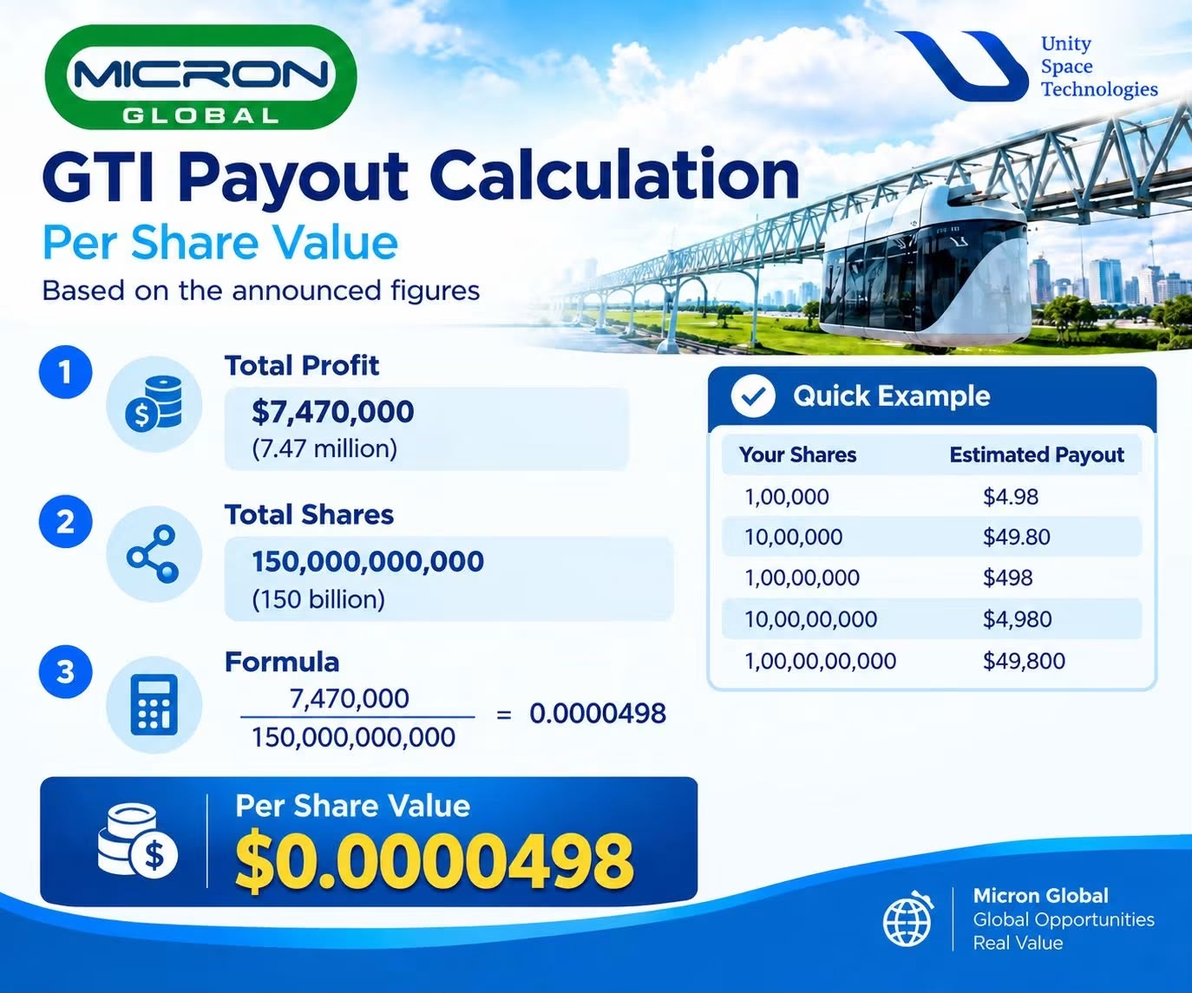
Dollar/share calculation

Slide 16
How to get a MicronGlobal account?
To Earn Money Effortlessly

Slide 17
Referral link
It is only possible to get a MicronGlobal account via a referral link.
My referral link is: https://micronglobal.com/ref/leoneeleman or
https://micronglobal.com/authentication/register/ref/leoneeleman

Slide 18
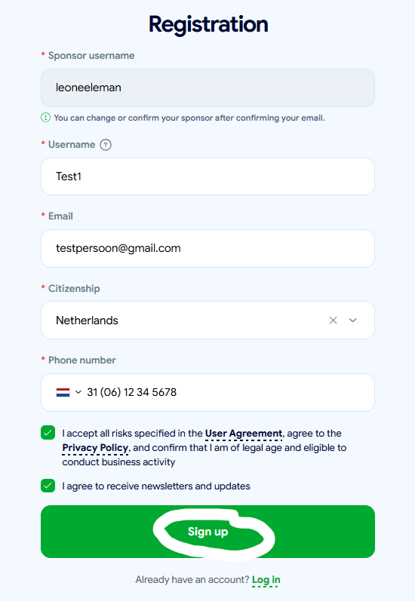

Slide 19
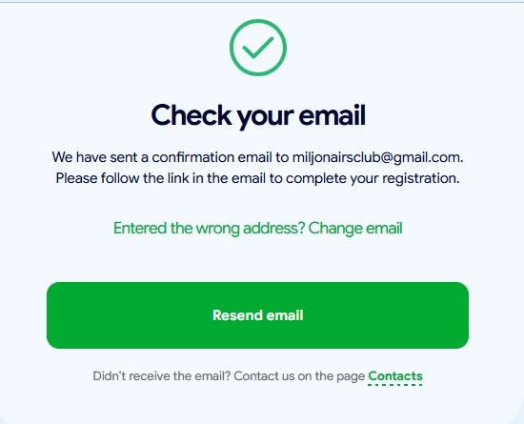

Slide 20
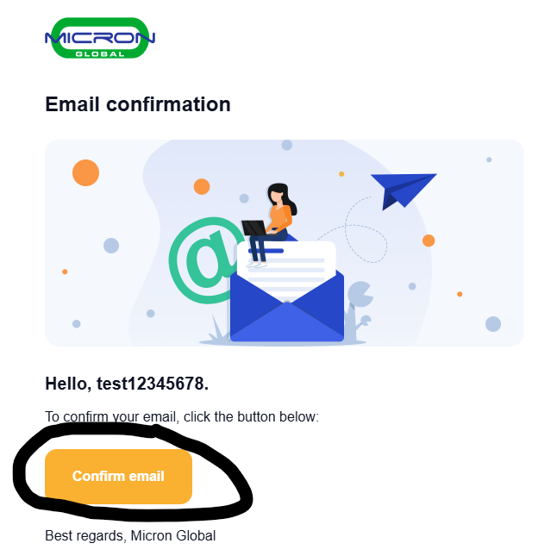

Slide 21
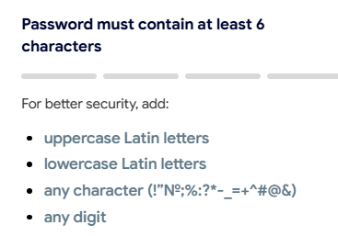
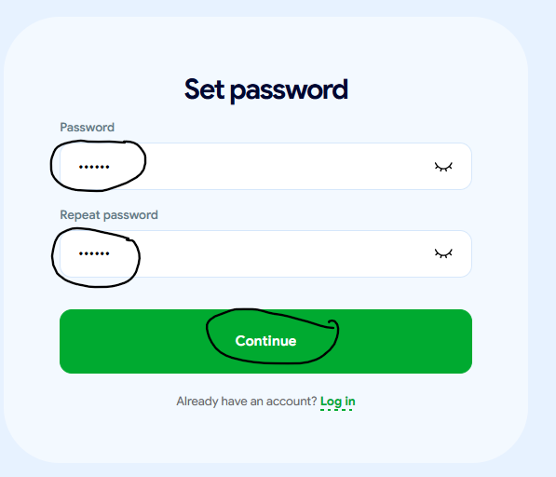

Slide 22
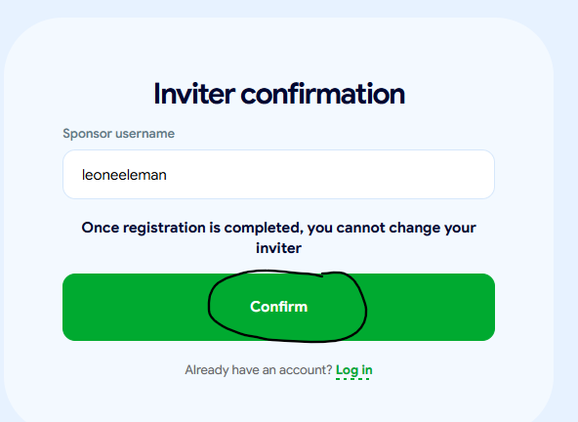

Slide 23


Slide 24
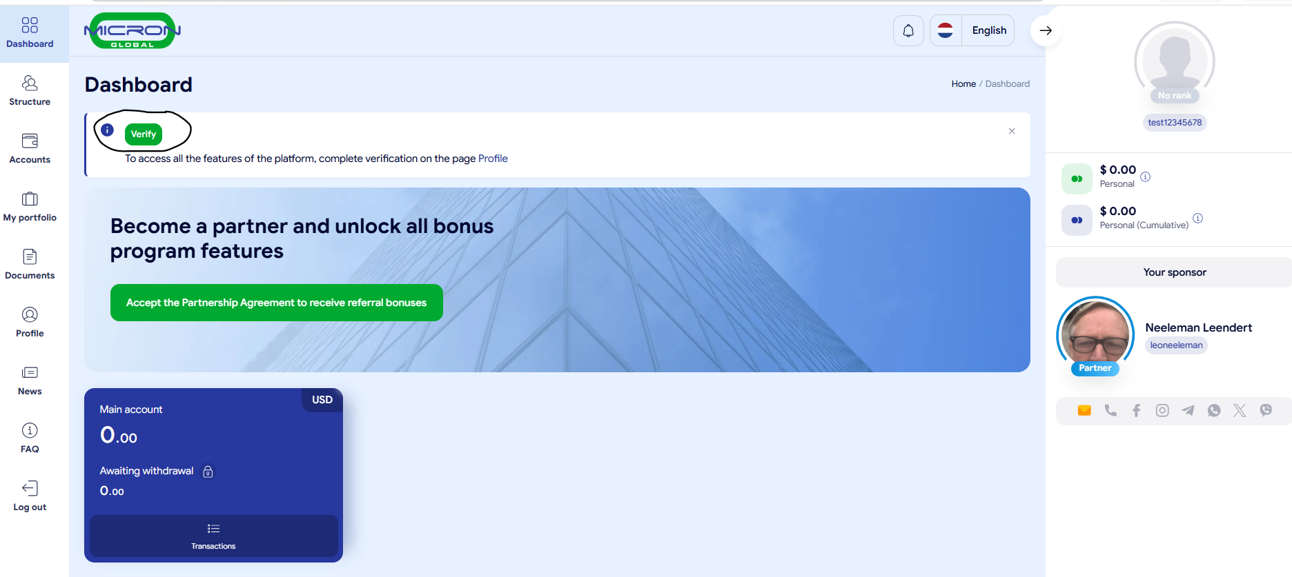

Slide 25
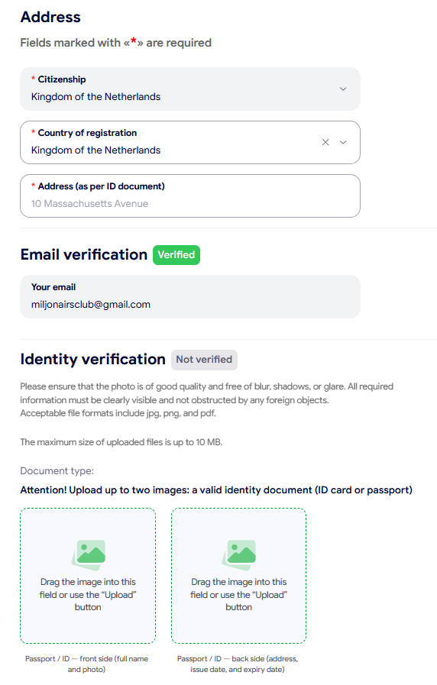
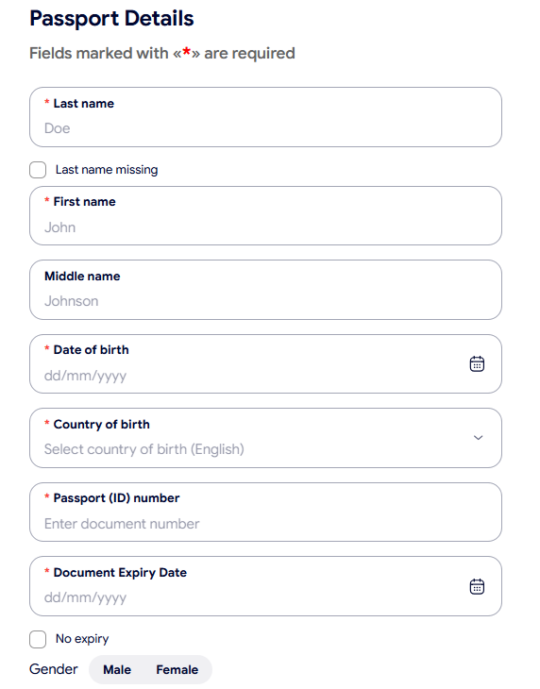

Slide 26
How do you view the stock options (portions)?
To Earn Money Effortlessly

Slide 27
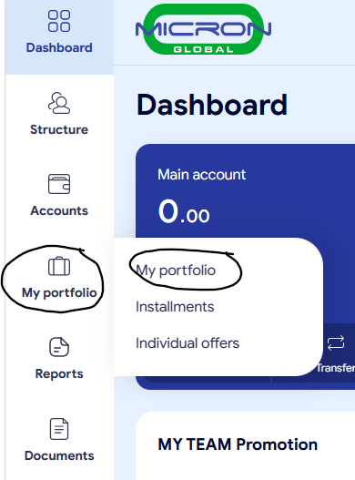

Slide 28
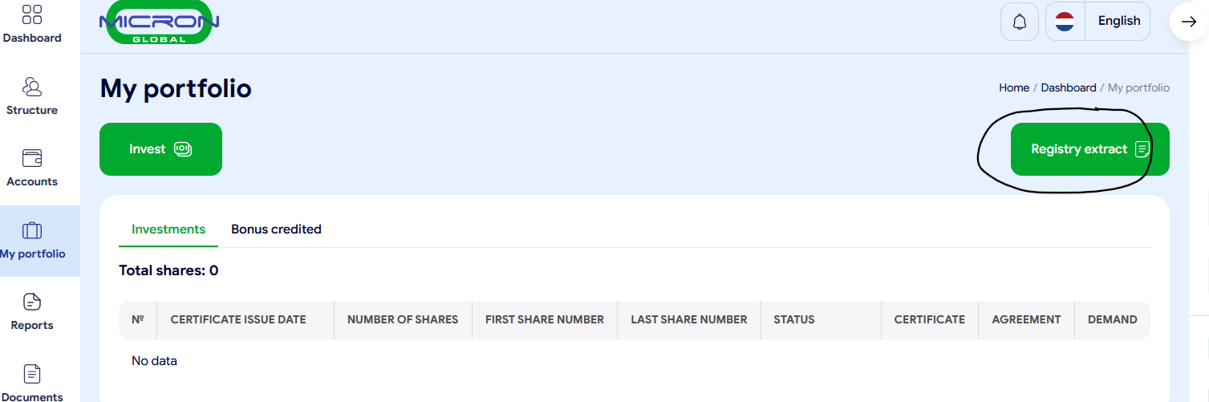

Slide 29
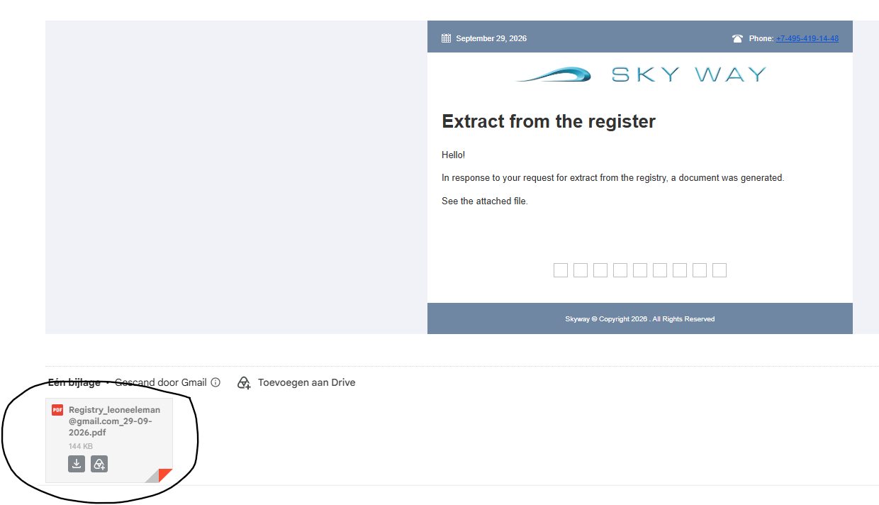

Slide 30
Tokens
To Earn Money Effortlessly

Slide 31
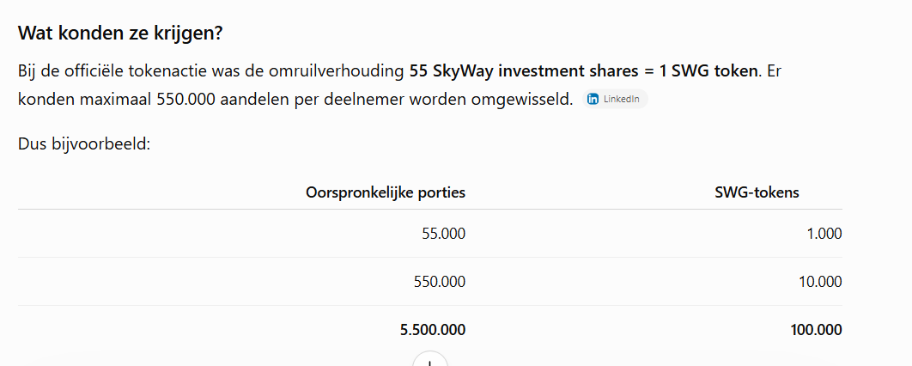

Slide 32
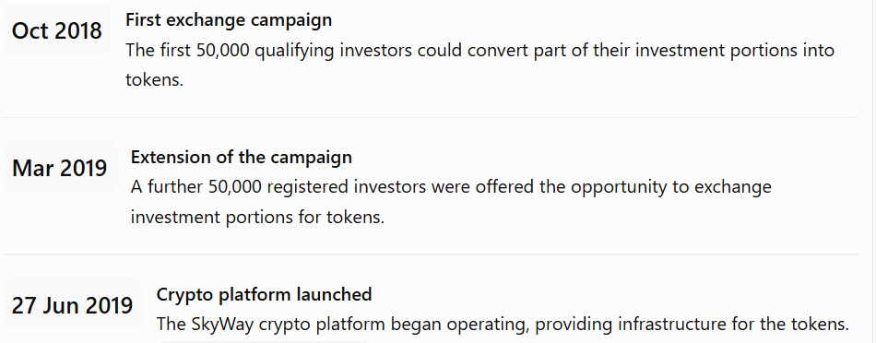

Slide 33
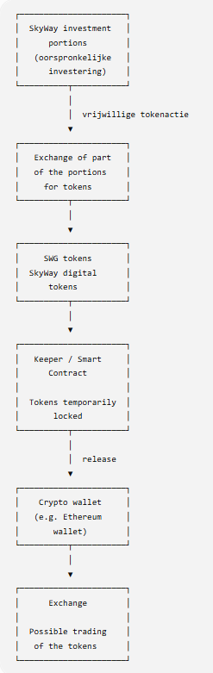
The historical price development of the SkyWay tokens has not been publicly disclosed in a reliable, continuous way. Therefore, we cannot determine how much 100,000 tokens were worth over the years.

Slide 34
To buy stock options (portions)
To Earn Money Effortlessly

Slide 35
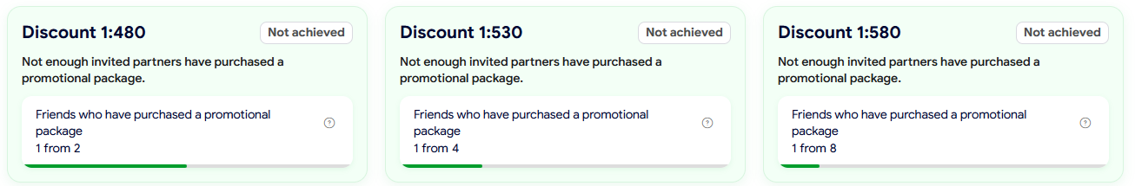
Actions through October 15 at 22.00 (Dutch time)
Log in your account and see the following action:

Slide 36
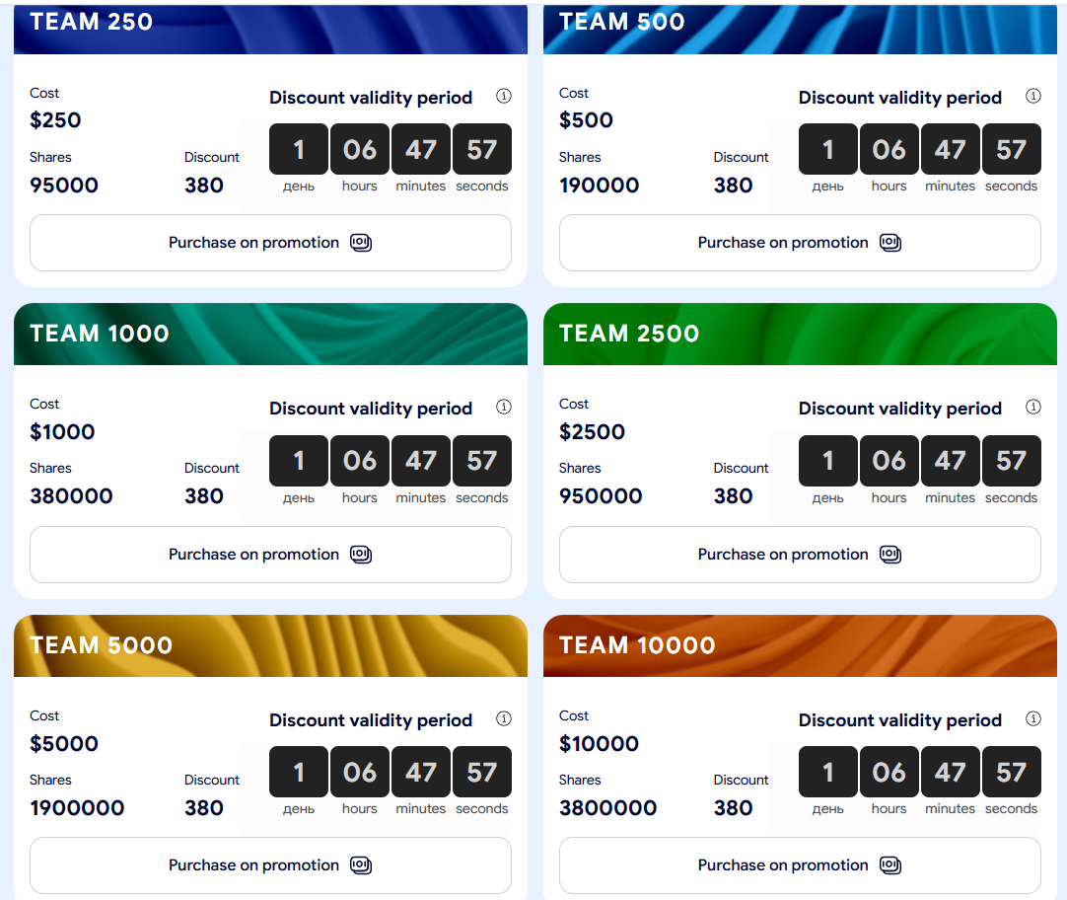
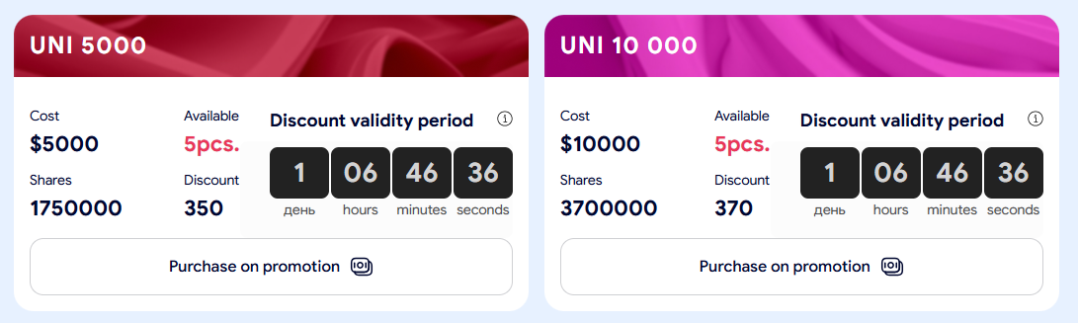
Actions through October 15 at 22.00 (Dutch time)
Log in your account and see the following action:

Slide 37
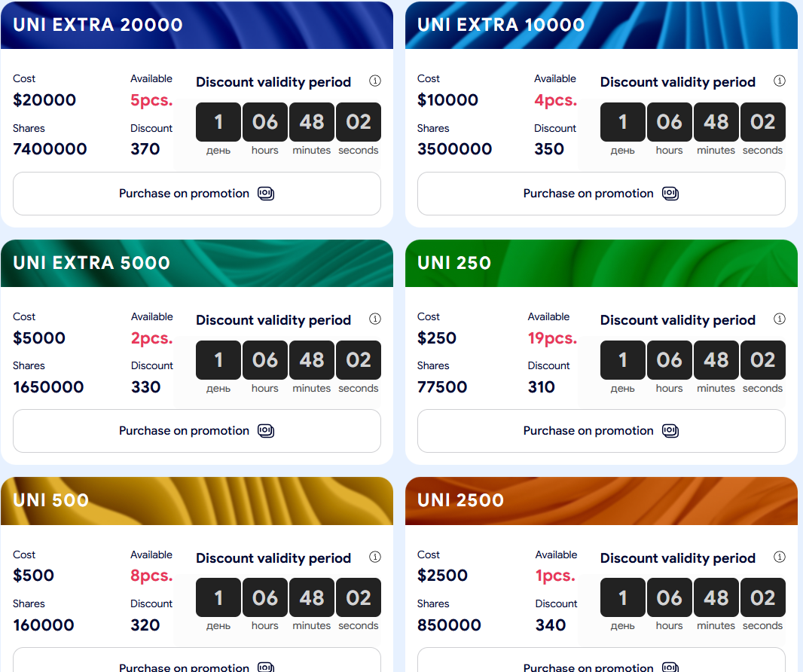
Actions through October 15 at 22.00 (Dutch time)
Log in your account and see the following action:

Slide 38
Any other business
To Earn Money Effortlessly

Slide 39
Any other business
Questions, remarks, additions, etc.
If you have questions afterwards please via miljonairsclub@gmail.com
If you want an 1:1 session to set up a XABclub account please let me know.
Disclaimer Only use money what you can loose and invest that money in 5 á 10 projects and use my 5-pillar strategy. Do the invest when you are in a neutral emotional state. I am not a financial advisor. I only give my personal experiences. Use the following rules: Asap your investment money back and after that the 50/50 rule.

