Slide 1
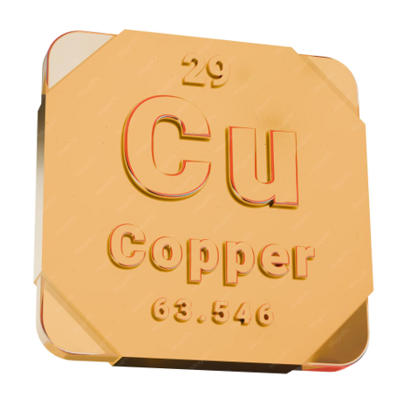
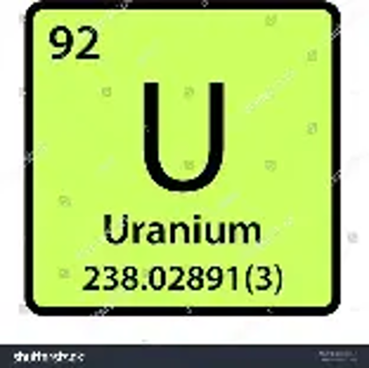
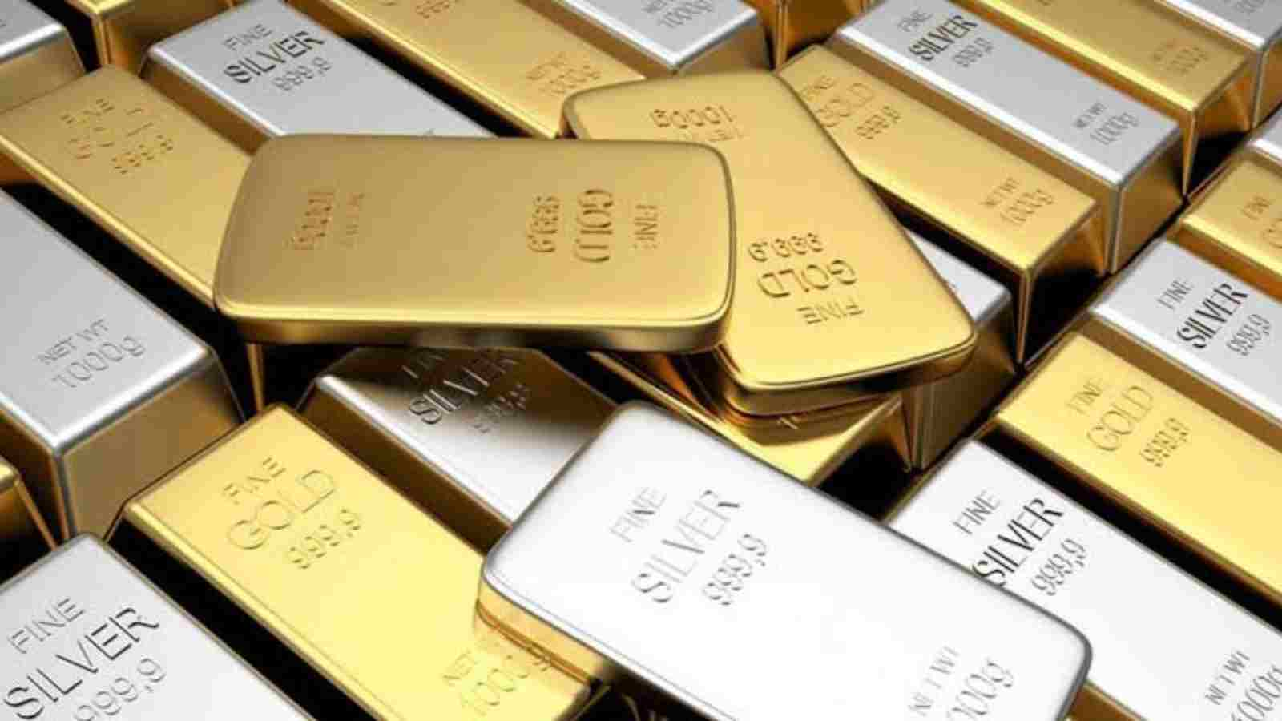

Pillar 1
Precious metals (gold/silver) and industrial metals (uranium/copper)
To Earn Money Effortlessly

Slide 2
My 5 pillar philosophy
Pillar 1: Investing in gold/silver and uranium/copper (15%)
Pillar 2: Real estate investments such as E-Estate and home equity (20%)
Pillar 3: Cryptocurrencies or crypto companies such as, XRPaibot (XABclub), VortexCapital, OrbitOne (formerly Aurum), BTC, XLM and XRP (25%), also crypto wallets
Pillar 4: Loans such as NeoFinance and FinoMark (15%)
Pillar 5: Special projects such as QFS projects, New York project, Future Tech project idea , Skyway (SWC → Micron Global), Bytnex (15%)
Cash: 10% of your spare money

Slide 3
Performance last year for gold/silver and uranium/copper
To Earn Money Effortlessly

Slide 4
Performance last year
(September 8, 2025 through September 8, 2026)
Gold: +22,5%
Silver: +62,9%
Uranium: +17,5%
Copper: +46,1%

Slide 5

Pillar 1 (gold/silver)
To Earn Money Effortlessly

Slide 6
What are precious metals?
Precious metals are metals that react little with their environment. They hardly oxidize, do not rust, and are often chemically very stable. Therefore, they are used in jewelry, electronics, coins, and industrial applications.

Slide 7
Why physical gold and silver?
The physical gold is intended for saving money. It is not an investment. You can get your money back within two working days. No profit distribution and no dividend distribution.
Silver is more an investment because it is more volatile than gold.

Slide 8
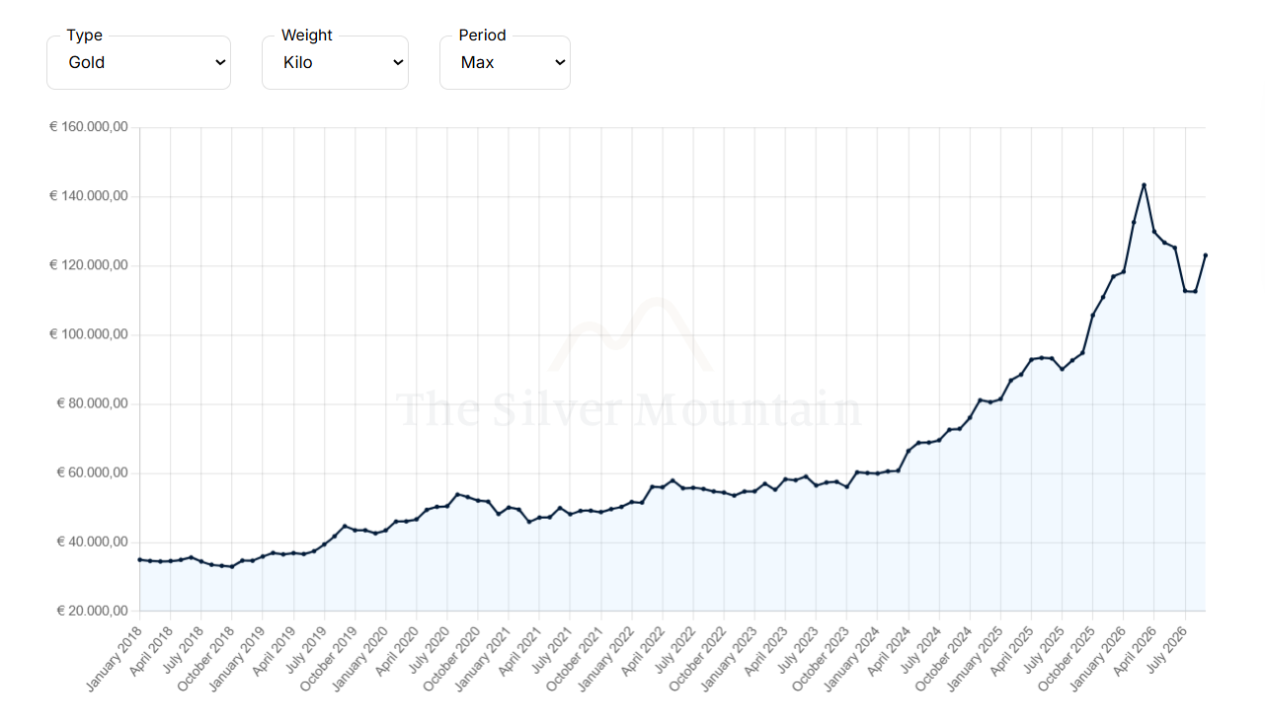
Historical goldprice
https://www.thesilvermountain.nl/en/gold-price

Slide 9
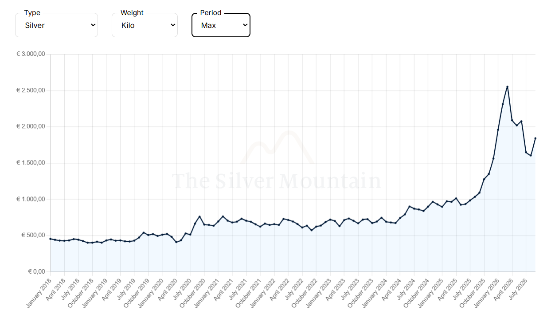
Historical silverprice
https://www.thesilvermountain.nl/en/silver-price

Slide 10
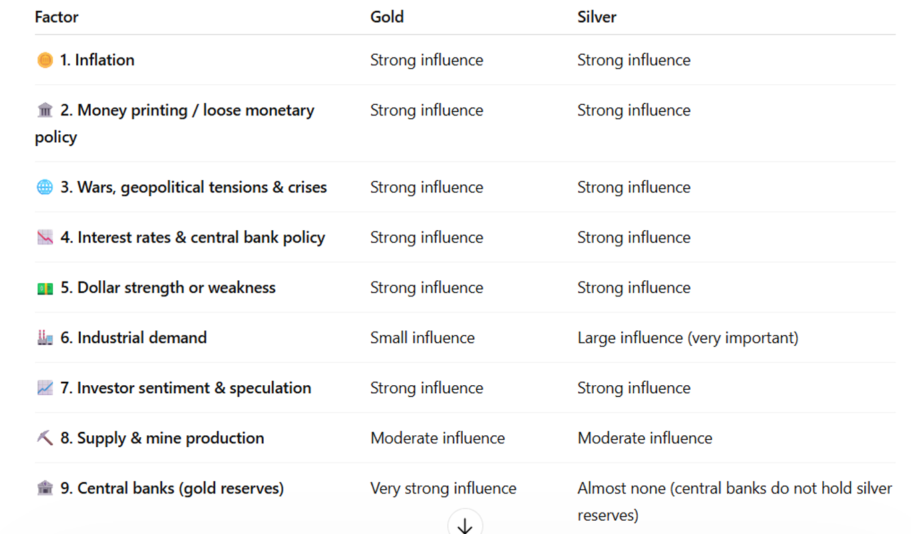

Slide 11
Two Dutch companies
From €50 via https://www.goud999safe.com and from €10 via https://www.hollandgold.nl (with an app)

Slide 12
Foreign companies
https://goldbusters.co.uk At Goldbusters itself, you usually do not invest directly. They mainly provide explanations and guide you through opening an account at https://www.auvesta.eu/ ,where you can buy the gold. You can start with approximately €/$25.
2) https://www.goldrepublic.com You can start with approximately €/$50

Slide 13
Eldorado Gold Corporation (EGO) via IRBK
Strong gold production: The company operates multiple gold mines in Canada, Greece, and Turkey, which reduces dependence on a single mine.
Growth catalyst: The large Skouries project in Greece is nearing the production phase and can significantly increase gold and copper production in the coming years.
Improved financial results: Revenue and net profit have risen sharply over the past period, partly due to higher gold prices and good operational performance.
For investors, the combination of growing production, strong cash flows, and the Skouries project are the most important positive factors.

Slide 14
Newmont Corp. (NEM) via IRBK
Newmont Corporation NEM is one of the largest gold producers in the world and is often seen as a "blue chip" within the gold mining sector.
The company primarily produces gold, but also holds copper, silver, zinc, and other metals.

Slide 15

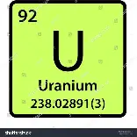
Pillar 1 (Uranium/Copper)
Moeiteloos Geld Verdienen

Slide 16
Why is uranium likely rising?
Growing nuclear power demand
Rising electricity demand from AI & data centers
Limited uranium supply
Slow development of new mines
Energy security and less dependence on Russia
Growth of Small Modular Reactors (SMRs)
Bottom line:
Higher demand + limited supply = potential upward pressure on uranium prices.

Slide 17
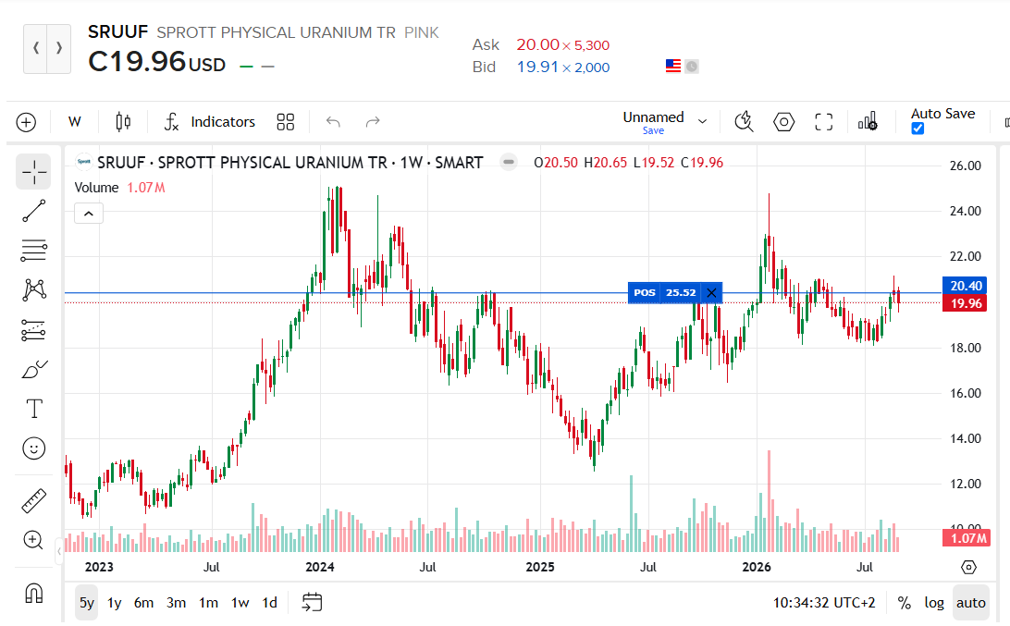
The 5-year card of uranium shares

Slide 18
The amount of reactors
At the end of 2025, there were still 436 reactors operational and 73 under construction.
In addition, there are 124 approved reactors on the drawing board (previously 117) and 331 reactors have been proposed (previously 318), but not yet officially approved.
But we are now seeing actual growth in the number of reactors, and thus in the demand for uranium.

Slide 19
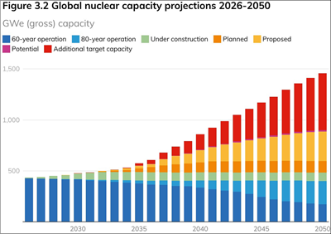
Nuclear capacity projections 2026 - 2050

Slide 20
Why will the demand for copper increase?
Virtually everything that uses electricity contains copper:
electricity grids
charging stations
electric cars
wind turbines
solar panels
data centers
AI infrastructure

Slide 21
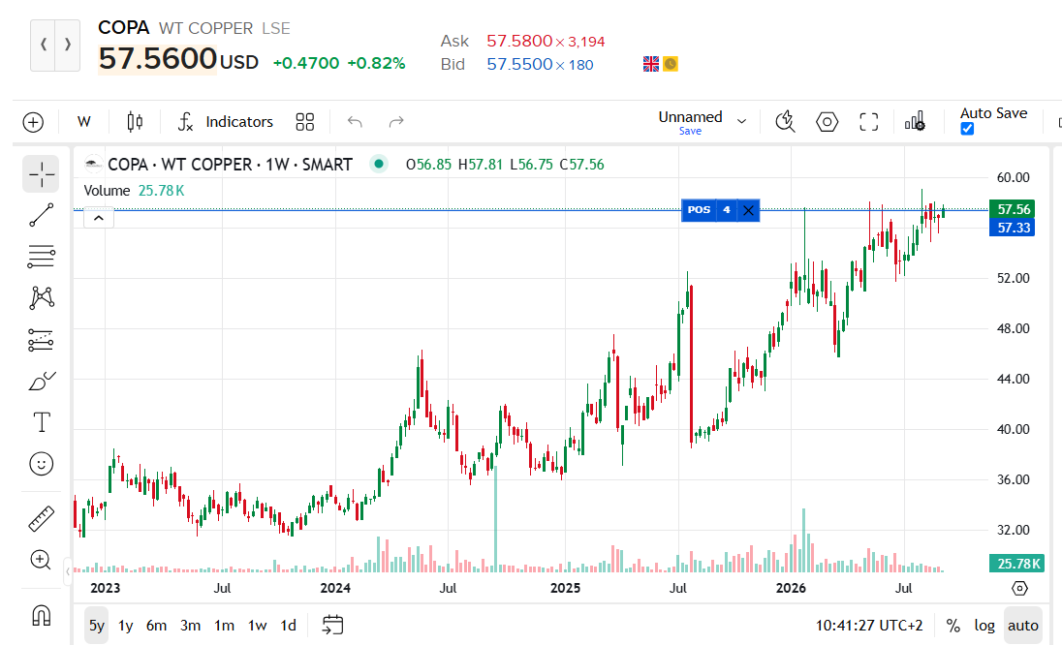
The 5-year chart of copper shares

Slide 22
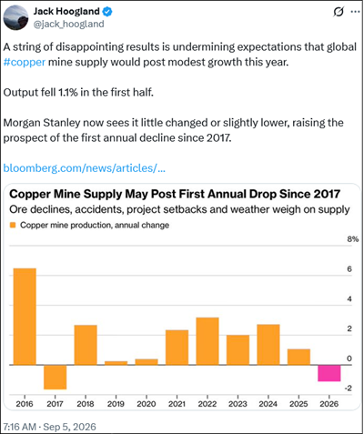
Copper mine supply
This is happening while demand for copper is currently rising at an accelerated rate, causing the copper shortage to escalate particularly rapidly.
However, those shortages are child's play compared to what we are going to experience over the next ten years.

Slide 23
IRBK
https://www.interactivebrokers.ie/en/home.php
You need to link a bank account for payments. I chose ABN AMRO.

Slide 24
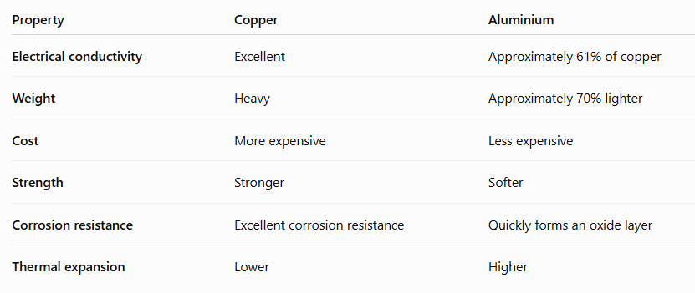
Differences between copper and aluminium

Slide 25
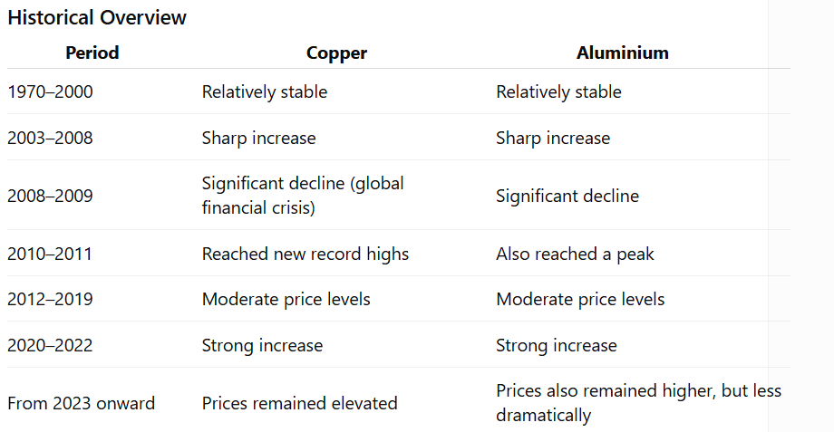

Slide 26
COPA
COPA on the LSE is not a mining company, but the WisdomTree Copper ETC (Exchange Traded Commodity). It tracks the price of copper via futures/commodity contracts and is therefore an investment product, not a company that produces copper.
Note: See the previous chapter on copper for further details.

Slide 27
SRUUF
Sprott Physical Uranium Trust is not a uranium producer, but a fund that holds physical uranium (U₃O₈).That makes it a relatively "pure" way to invest in the uranium price.
Note: See what was written earlier about uranium.

Slide 28
Cameco Corp.
Cameco Corporation (NYSE/TSX: CCJ) is one of the largest and most established uranium producers in the world. The company is a direct investment in the growth of nuclear energy and the uranium cycle.

Slide 29
Energy Fuels Corp. (UUUU)
Energy Fuels is a more speculative growth version of Cameco. It has more potential during a uranium and commodities boom, but also more execution risk because the rare earth strategy still needs to be proven.
In a portfolio alongside Cameco (quality/producer) and Sprott Physical Uranium (pure uranium price), UUUU is primarily the high-risk/high-upside potential position.

Slide 30
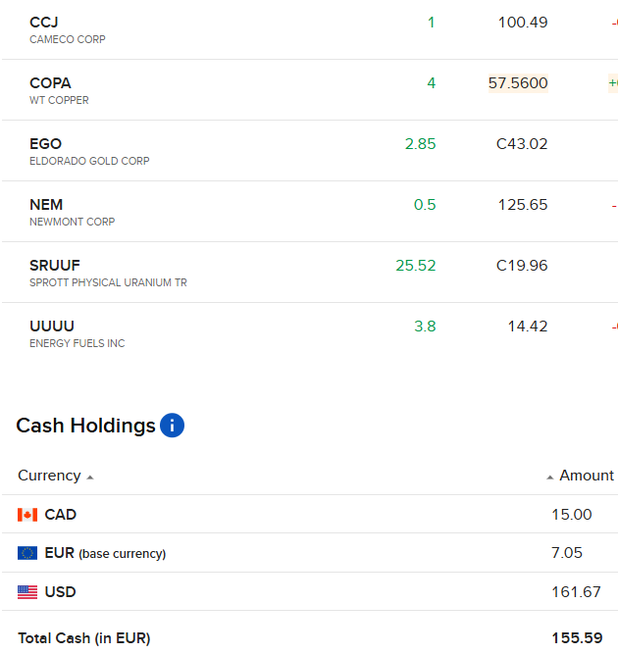
Overview of my positions with IRBK

Slide 31
Any other business
Questions, remarks, additions, etc.
If you have questions afterwards please via miljonairsclub@gmail.com
Disclaimer Only use money what you can loose and invest that money in at least 10 projects and use my 5-pillar strategy.
Do the invest when you are in a neutral emotional state.
I am not a financial advisor. I only give my personal experiences.
Use the following rules: Asap your investment money back and after that the 50/50 rule.

